Slide 1
ENSE 471, Milestone 1
February 6th, 2019

Slide 2
!Cool
Taylen Jones
Joseph Bello
Brandon Clarke

Slide 3
Prep & review stage
Engineering sites reviewed
University of Calgary
University of Saskatchewan
University of Regina
Overall Gathered Data
Dislikes:
Out of date info/links
Too much/ poorly organized information
Wants:
Intuitive organization
Compact organization

Slide 4
Target customers & observe stage
Target Customers:
Current Students - Taylen
More clear view of approved electives, when they are offered
Important upcoming dates
Future Students - Brandon
Acceptance GPA
Required High School Courses
Program Overview and Career Prospect
Faculty and staff - Joseph
A way to compact information
Intuition: how easy it is to find things
A way to provide a lot of information without making it overwhelming

Slide 5
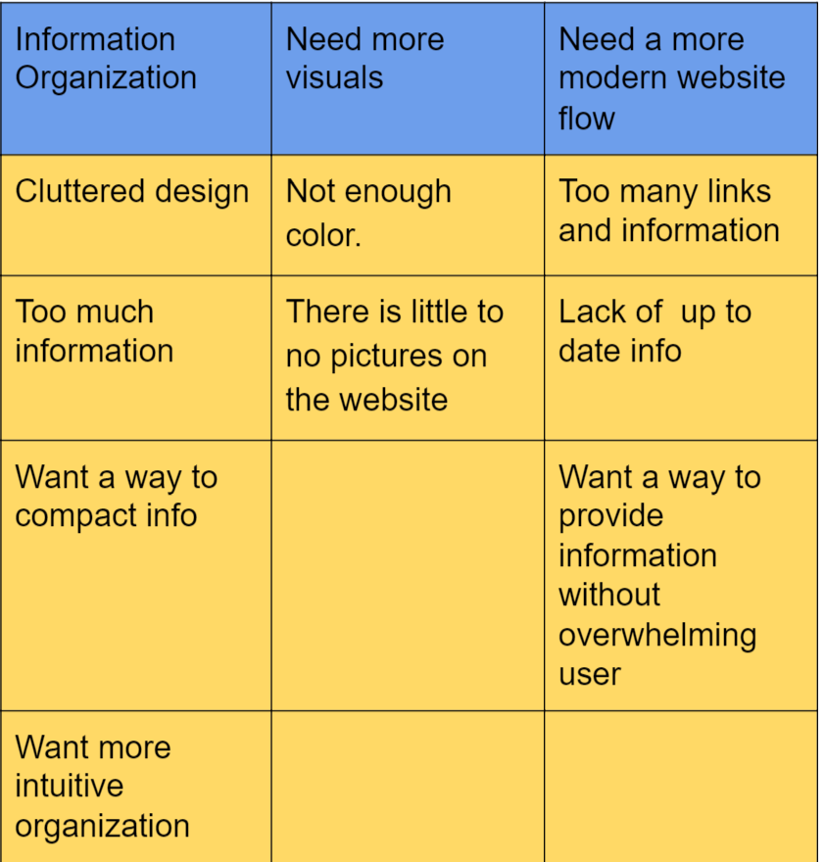
Affinity Diagram

Slide 6
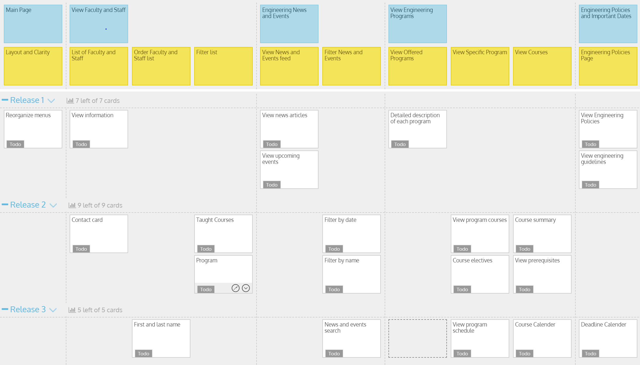
Framing Stage

Slide 7
Github Review
Github Link: https://github.com/jones35t/NotCool

Slide 8
Group Reflection
•How did you feel about this milestone? What did you like about it? What did you dislike?
•What did you learn about yourself as you collaborated and worked through this milestone?
•How will you use what you have learned going forward?
•What “stuff & things” related to this milestone would you want help with?
•We weren’t really clear about the affinity diagram

